Slide 1
Pulse PT
Rafael Montes
Parth Desai
Sam Bohr
Andrew Alhaj
Daniel Christenson
Julian Ajja

Slide 2
Risks and Challenges
Coming up with intuitive UI designs
Using Firebase Storage
Asynchronous code
API Calls
Using Firebase
Rafael
Sam
Andrew
Daniel
Julian

Slide 3
User Stories UI Deisgn
As a trainee I would like to be able to easily view my assigned routines so that I can do them efficiently
As a trainer I would like to be able to view and easily edit my assigned routines to my clients so that I can adjust their regimen on the fly based on their response.
As a trainee I would like to be able to see some type of clear image of my heart rate info so that I know I am getting an effective workout.

Slide 4
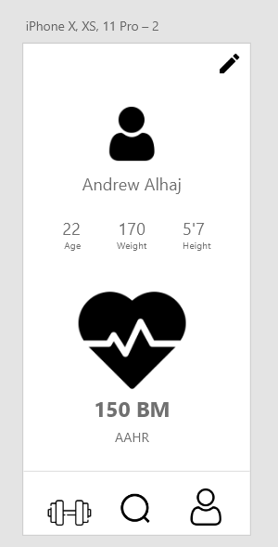
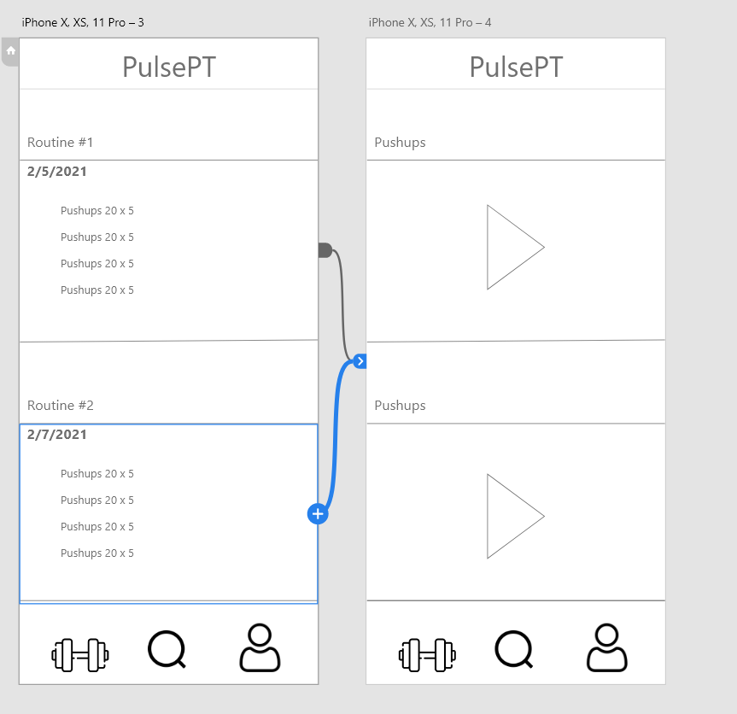
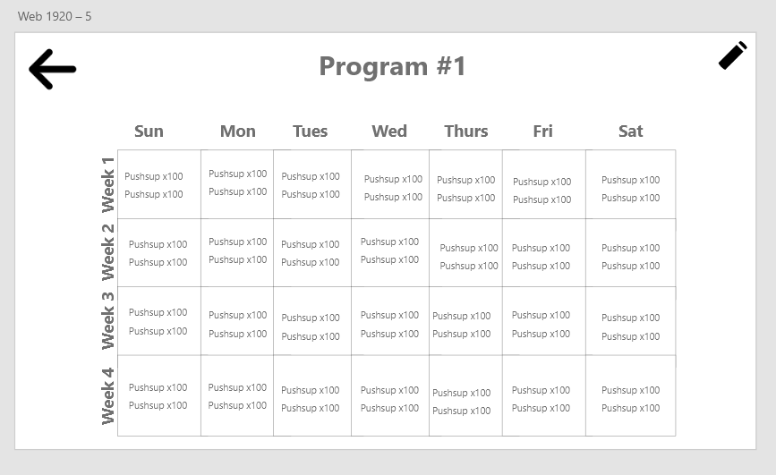
Conceptual UI Design

Slide 5
Subscriber Page
As a trainer, I’d like to see a list of my clients by first and last name.
Conceptual UI
Creating an API call
Axios to retrieve data
Testing

Slide 6
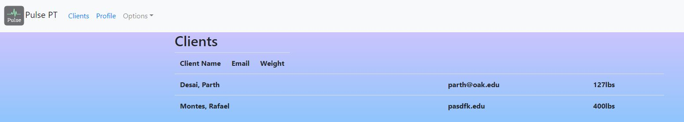
Trainer Subscriber Page

Slide 7
User Stories for Mobile Homepage
As a trainee I’d like to be able to upload a picture of myself for my profile.

Slide 8
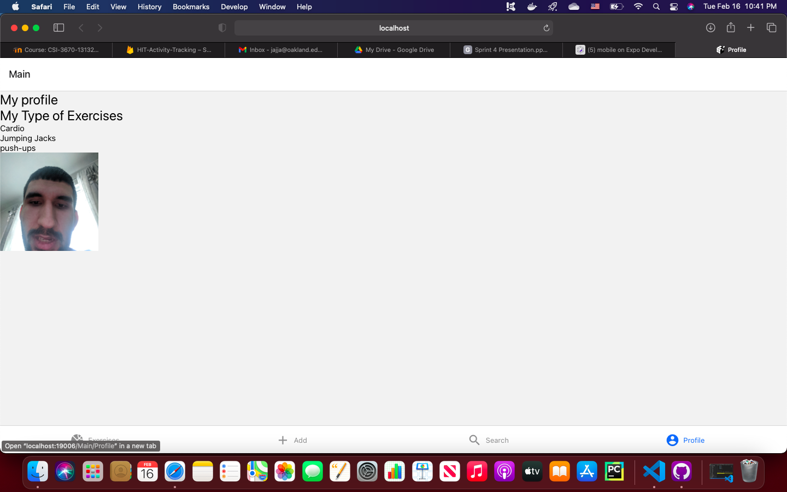
Mobile Home Page

Slide 9


Dashboard Page
User Story: As a trainer, I would like to view a dashboard page to easily navigate the website
Research
Create Jumbotrons
Add CSS
Link Jumbotron Items with Route
Test

Slide 10
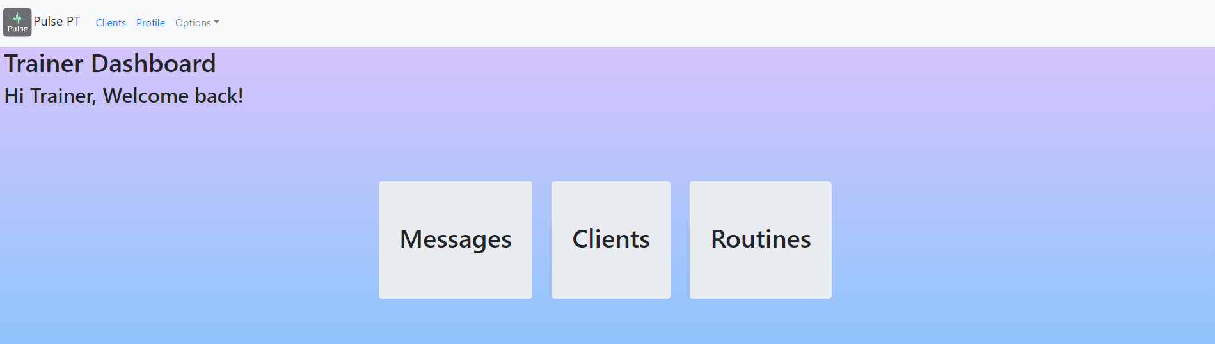
Dashboard Page

Slide 11

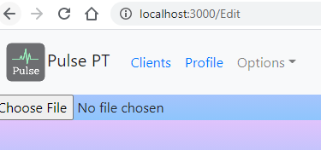
Profile Picture
User Story: As a trainer, I would like to be able to upload a picture to my profile
Research
Create Edit component
Link file to firebase storage
Test

Slide 12
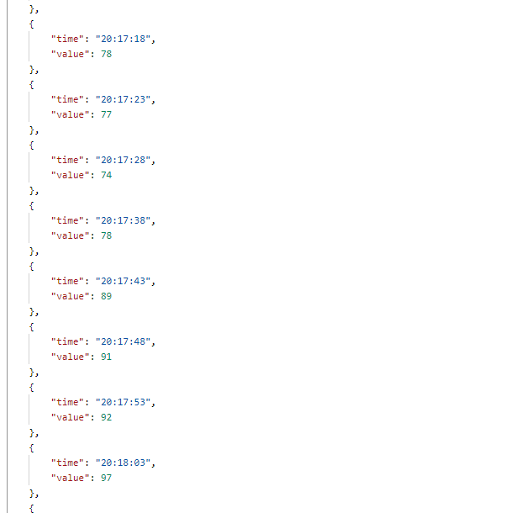
Heart Rate Data
User Story: As a subscriber, I would like to retrieve heart rate data from my fitbit.
Users download fitbit app
Register app on https://dev.fitbit.com/
Able to make API calls using OAuth 2.0

Slide 13
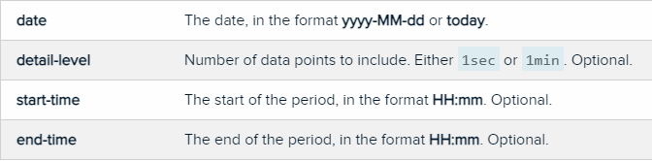
API calls
GET https://api.fitbit.com/1/user/-/activities/heart/date/[date]/[end-date]/[detail-level].json
GET https://api.fitbit.com/1/user/-/activities/heart/date/[date]/[end-date]/[detail-level]/time/[start-time]/[end-time].json
GET https://api.fitbit.com/1/user/-/activities/heart/date/[date]/1d/[detail-level].json`
GET https://api.fitbit.com/1/user/-/activities/heart/date/[date]/1d/[detail-level]/time/[start-time]/[end-time].json

Slide 14
Mobile This Sprint
Subscriber
Axios, Express and Mongoose Calls
I would like my profile page to display my name, age, weight and height.
I would like a button on the profile page that allows me to log out

Slide 15
Next Sprint Objectives
Create Workout Routines (Mobile)
Display Trainers in a search (Mobile)
Create interface for selecting workouts (Web)
Create workout page1: Create workout (Web)
Create workout page2: Create routine from workout (Web)
Search Feature UI/UX
As a subscriber, I would like a button on the weight attribute of my profile page to update my weight as I progress(Mobile)
As a Subscriber, I’d like to have a button to login to my fitbit account to authorize the health data retrieval (Mobile)

Slide 16
Demo

Slide 17
THANKS

